Slide 1

Apache Hive
Data warehouse software facilitates reading, writing, and managing large datasets residing in distributed storage and queried using SQL syntax.

Slide 2
Hive Features ?
Hive is build at the top of Map Reduce and provides below features
Tools to enable easy access to data via SQL, thus enabling data warehousing tasks such as extract/transform/load (ETL), reporting, and data analysis.
A mechanism to impose structure on a variety of data formats
Query execution via various executions engines like Tez, Spark and Map Reduce
Provides standard SQL functionality, including many of the later SQL:2003 and SQL:2011 features for analytics.
There is no specific Hive format that data must be stored, but various connectors to read and write Text, CSV data. More connectors can be added !
Hive Supports Schema on read.

Slide 3
What Hive Can do ?
Hive Data Definition Language
CREATE/ DROP /ALTER / USE Database
CREATE/ DROP/Truncate Table
ALTER Table/Partition/Column
CREATE/ALTER/DROP View
CREATE/ALTER/DROP Index
CREATE/DROP/GRANT/REVOKE Roles and Privileges
Hive Data Manipulation Language
LOAD, INSERT, UPDATE, DELETE
Data Retrieval
SELECT, WHERE, SORT
GROUP BY
JOINS
UNIONS
SUB QUERIES
EXPLAIN
File Formats
Avro File Format
ORC File Format
Parquet
LZO Compression

Slide 4
What HIVE is not ?
Hive is not a RDBMS !
Hive is not designed for online transaction processing (OLTP) workloads.
It is best used for traditional data warehousing tasks.
Even with small amount of data time to return the response can’t be compared to RDBMs

Slide 5
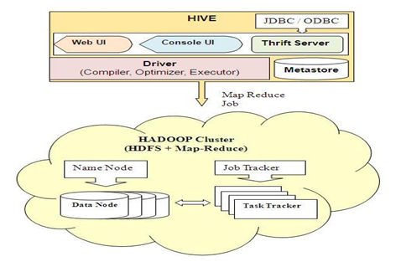
Hive Architecture

Slide 6
Hive Architecture Components
UI – The user interface for users to submit queries and other operations to the system. command line interface and a web based GUI are available.
Driver – The component which receives the queries.
Compiler – The component that parses the query, does semantic analysis on the different query blocks and query expressions and eventually generates an execution plan with the help of the table and partition metadata looked up from the metastore.
Metastore – The component that stores all the structure information of the various tables and partitions in the warehouse including column and column type information, the serializers and deserializers necessary to read and write data and the corresponding HDFS files where the data is stored.
Execution Engine – The component which executes the execution plan created by the compiler.
Thrift Hive Server2 - HiveServer2 (HS2) is a service that enables clients to execute queries against Hive. HiveServer2 is a container for the Hive execution engine. For each client connection, it creates a new execution context that serves Hive SQL requests from the client.
Beeline CLI: Hive 0.11 also includes a new command-line interface (CLI) called Beeline that works with HiveServer2.
HCatalog - is a component of Hive. It is a table and storage management layer for Hadoop that enables users with different data processing tools — including Pig and MapReduce — to more easily read and write data on the grid.

Slide 7
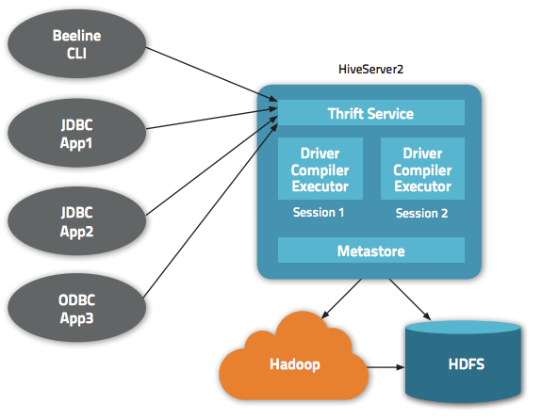
HiveServer2 Architecture

Slide 8
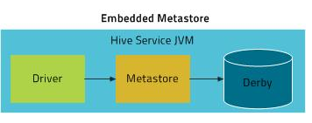
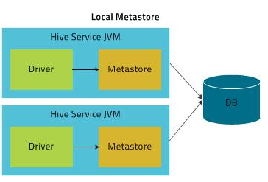
Hive Metastore
Metastore is the central repository of Apache Hive metadata. It stores metadata for Hive tables (like their schema and location) and partitions in a relational database.
Modes for Hive Metastore deployment:
Embedded Metastore
In Hive by default, both metastore service and hive service runs in the same JVM by using embedded Derby Database limits only one Hive session could be open at a time.
Local Metastore
Allows to have many Hive sessions to use the metastore at the same time. This configuration is called as local metastore because metastore service still runs in the same process as the Hive. But it connects to a database running in a separate process, either on the same machine or on a remote machine.
MySQL is a popular choice for the standalone metastore.
To connect hive use jdbc:mysql://host/dbname? createDatabaseIfNotExist=true

Slide 9
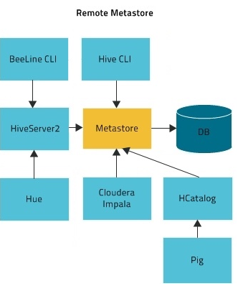
Hive Metastore
Remote Metastore
Used mostly in production environment
metastore runs on its own separate JVM not in the Hive service JVM.
Metastore runs preferably in a separate machine and can be optionally firewalled to enable security, Other processes need to use Thrift Network APIs to communicate with the metastore server .
To connect hive use metastore server URIs like, thrift://host:port

Slide 10
Serde
Serde is acronym for Serializer/Deserializer in Hive.
Serde is used by Hive to control IO . Means, how different format of data is read and written in files.
When used as Serializer (i.e. insert) table’s SerDe will serialize hive’s internal representation of row of data into bytes written to output file.
When used as Deserializer (i.e. querying the data), SerDe will de-serialize a row of data from bytes in file to objects.
E.g.
org.apache.hadoop.hive.serde2.lazy.LazySimpleSerDe
org.apache.hadoop.hive.ql.io.orc.OrcSerde
org.apache.hadoop.hive.serde2.columnar.ColumnarSerDe
org.apache.hadoop.hive.ql.io.parquet.serde.ParquetHiveSerDe
org.apache.hadoop.hive.serde2.avro.AvroSerDe

Slide 11
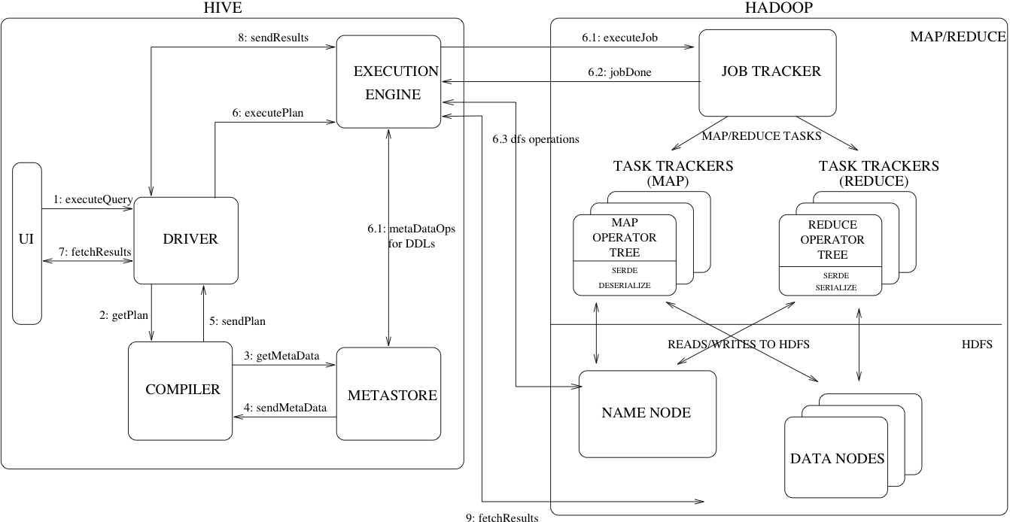
Query flow

Slide 12
Database
To see all databases of hive
show databases;
create database
create database if not exists cricdb comment 'holds cricket data';
To see the database detailed
describe database cricdb ;
Drop database
DROP DATABASE IF EXISTS cricdb CASCADE; (If DB contains table)
To use any database
use cricdb ;
show tables; //see the list of tables in cricdb.

Slide 13
Create table in hive
Create a data directory in HDFS to store hive table data
hadoop fs -mkdir hivetabledata
hadoop fs -cp SampleDataFile/CricketScore.txt hivetabledata
Create managed table
Create table cricdb.cricdata (pname string, score int, balls int,sixes int,fours int,mins int) row format delimited fields terminated by '\t' location '/user/notroot/hivetabledata';
select * from cricdb.cricdata;
Create external table
Create EXTERNAL table cricdb.cricdata_ext(pname string, score int, balls int,sixes int,fours int,mins int) row format delimited fields terminated by '\t' location '/user/notroot/hivetabledata';
The Hive can run in interactive mode using Shell as well as in non-interactive mode.
hive -f script.hql
hive -e 'SELECT * FROM cricdb.cricdata;'

Slide 14
External VS Managed Table
Use EXTERNAL tables when:
The data is also used outside of Hive. For example, the data files are read and processed by an existing program that doesn't lock the files.
Data needs to remain in the underlying location even after a DROP TABLE. This can apply if you are pointing multiple schemas (tables or views) at a single data set or if you are iterating through various possible schemas.
You want to use a custom location such as ASV.
Hive should not own data and control settings, dirs, etc., you have another program or process that will do those things.
You are not creating table based on existing table (AS SELECT).
Use MANAGED tables when:
The data is temporary.
You want Hive to completely manage the lifecycle of the table and data.
When external table is dropped only table is dropped i.e metadata is updated but data remains as is. If a managed table is dropped it also deletes the data.

Slide 15
Create table as select
Create table as select from other existing table
create table playerscore row format delimited fields terminated by ',' as select pname,score from cricdata;
select * from playerscore;
Creates a new table schema only with existing table schema
create table cricdata1 like cricdata;
To see the create table statement of table
show create table cricdata;
Describe any table
describe extended cricdata;

Slide 16
Other table operations
Truncate any table data
Truncate table playerscore ;
Note: Truncate does not work on external table
Add a new column to table
ALTER TABLE cricdata ADD COLUMNS (rate float);
Change column name of a table
ALTER TABLE cricdata CHANGE pname player_name varchar(30);
Rename a table
Alter table cricdata RENAME to cricketdata;
Remove all existing columns with new columns
ALTER TABLE cricketdata REPLACE COLUMNS (name varchar(20), score int);
Removes all the existing columns and replaces them with the new columns specified
Select * from cricketdata; //Note It fetches only 2 columns from data
Delete the table
DROP TABLE cricketdata; //Drop any external table and verify if data is still available.

Slide 17
Load Data into table
Insert data using LOAD statement
Create table cricdb.cricdata(pname string, score int, balls int,sixes int,fours int,mins int) row format delimited fields terminated by '\t' location '/user/notroot/hivetabledata';
LOAD DATA local inpath 'SampleDataFile/CricketScore.txt' OVERWRITE into table cricdata;
Insert Data from existing table
Create table cricdb.cricdata1(pname string, score int) row format delimited fields terminated by '\t';
INSERT OVERWRITE table cricdata1 select pname, score from cricdata;
Multi table Insert
Create table cricdb.cricdata_100(pname string, score int) row format delimited fields terminated by '\t';
Create table cricdb.cricdata_50(pname string, score int) row format delimited fields terminated by '\t';
From cricdata INSERT OVERWRITE TABLE cricdata_100 select pname, score where score>=100 INSERT OVERWRITE TABLE cricdata_50 select pname, score where score>49 and score<100;

Slide 18

Select Command
To Print header while select data from table
set hive.cli.print.header=true;
GROUP BY ..HAVING
SELECT pname, avg(score) as AVERAGE FROM cricdata GROUP BY pname,score having score > 50;
GROUP BY statement is often used in conjunction with aggregate functions
DISTRIBUTE BY
set mapreduce.job.reduces = 10;
SELECT s.* FROM cricdata s DISTRIBUTE BY s.pname;
DISTRIBUTE BY controls how map output is divided among reducers to avoid data skew.

Slide 19
Hive functions
FUNCTIONS LIKE UPPER, CAST, ROUND
SELECT upper(pname), score, CAST(round(score/balls *100) as FLOAT) as StrikeRate from cricdata;
OTHER Hive Functions
floor()
ceil()
rand()
exp()
length()
concat()
substr()
lower()
etc

Slide 20
Sort by, order by and CLUSTER BY
Sort by
SELECT s.pname,s.score FROM cricdata s SORT BY s.pname;
May use multiple reducers for final output
Only guarantees ordering of rows within a reducer
May give partially ordered final result
Order by
SELECT s.pname,s.score FROM cricdata s ORDER BY s.pname;
Uses single reducer to guarantee total order in output
LIMIT can be used to minimize sort time
CLUSTER BY (set mapreduce.job.reduces=5;)
short-hand for the DISTRIBUTE BY and SORT BY on same column
SELECT s.* FROM cricdata s CLUSTER BY s.pname;
SELECT s.* FROM cricdata s DISTRIBUTE BY s.pname SORT BY s.pname;

Slide 21
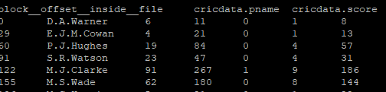
ROW_NUM and VIRTUAL COLUMNS in Hive
VIRTUAL COLUMNS
Hive VIRTUAL COLUMNS as input file's name for a mapper task and current global file position.
SELECT BLOCK__OFFSET__INSIDE__FILE,* from cricdata;
SELECT INPUT__FILE__NAME,* from cricdata;
ROW_NUMBER()
select row_number() OVER (ORDER BY pname) as row_num , * from cricdata;
ROW_NUMBER() is a windowing function so it needs to be used in conjunction with an OVER clause

Slide 22
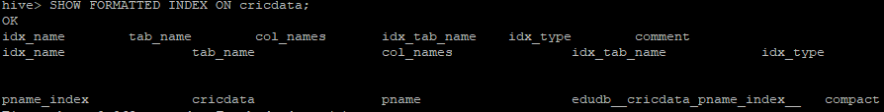
Index
There are 2 types of Index supported in hive.
COMPACT (Used for more distinct valued columns, e.g. pname)
BITMAP (Used for fewer distinct valued columns e.g. country)
create index pname_index on table cricdata(pname) as 'COMPACT' WITH DEFERRED REBUILD;
To build the index
ALTER INDEX pname_index on cricdata rebuild;
To see the Index details of a table
SHOW FORMATTED INDEX ON cricdata;
Observe the Index table name created for storing index information
To see how the index data is maintained
select * from cricdb__cricdata_pname_index__;
To Drop any index
DROP INDEX IF EXISTS pname_index ON cricdata;

Slide 23
JOIN
Create table cricdata_pname(pid int, pname string) row format delimited fields terminated by ',';
Create table cricdata_pscore(pid int, score int, balls int) row format delimited fields terminated by ',';
LOAD DATA local inpath 'SampleDataFile/PlayerID_Name.csv' OVERWRITE into table cricdata_pname;
LOAD DATA local inpath 'SampleDataFile/playerID_Score_Balls.csv' OVERWRITE into table cricdata_pscore;
INNER JOIN
Select pn.pname,ps.score from cricdata_pname pn join cricdata_pscore ps ON(pn.pid=ps.pid);

Slide 24
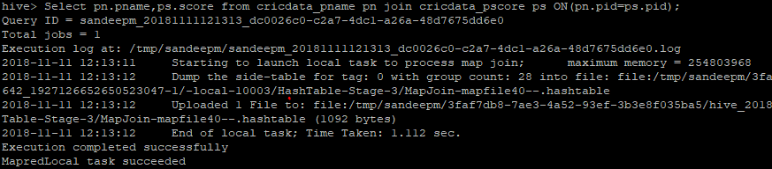
Other Types of JOINs
LEFT OUTER JOIN
Select pn.pname,ps.score from cricdata_pname pn left outer join cricdata_pscore ps ON(pn.pid=ps.pid);
RIGHT OUTER JOIN
Select pn.pname,ps.score from cricdata_pname pn right outer join cricdata_pscore ps ON(pn.pid=ps.pid);
FULL OUTER JOIN
Select pn.pname,ps.score from cricdata_pname pn full outer join cricdata_pscore ps ON(pn.pid=ps.pid);
Use Map Join where possible
Set hive.auto.convert.join = true;

Slide 25
VIEWs
Hive view is similar to SQL view which we can define by the query.
It is also refered as “virtual tables”. Hence, we can query a view like we can a table.
create view cricview(name,score,balls) as select pname,score,balls from cricdata;
select * from cricview;
By using joins it is possible to combine data from or more table.
create view cricview_join(name,score) as Select pn.pname,ps.score from cricdata_pname pn join cricdata_pscore ps ON(pn.pid=ps.pid);
select * from cricview_join;
To describe a view
DESCRIBE EXTENDED cricview_join;
To drop a view
Drop view cricview;

Slide 26
RC/ORC - Storage Format
RC: Record Columnar File
RCFile format storage minimize the space up to 14% in HDFS by changing the format of the data using the MapReduce framework.
create table cricdata_RC(pname string, score int, balls int,sixes int,fours int,mins int) stored as RCFILE;
INSERT OVERWRITE TABLE cricdata_rc SELECT * FROM cricdata;
ORC: Optimized Row Columnar File
Column oriented storage format.
Originally it is Hive's Row Columnar file. Now improved as Optimized RC (ORC)
Schema is with the data, but as a part of footer.
Data is stored as row groups and stripes.
Each stripe maintains indexes and stats about data it stores.
ORC format provides a more efficient way to store data, reducing the storage by up to 75% of the original. ORC takes less time to access data, However, increases CPU overhead to decompress the relational data.
create table cricdata_ORC(pname string, score int, balls int,sixes int,fours int,mins int) stored as ORC;
INSERT OVERWRITE TABLE cricdata_orc SELECT * FROM cricdata;

Slide 27
Parquet/AVRO Storage Format
Parquet format
Similar to ORC.
Schema stored in footer.
A Column oriented storage format which has integrated SNAPPY compression
when specific columns needs to be retrieved this format is excellent.
create table cricdata_par(pname string, score int, balls int,sixes int,fours int,mins int) stored as parquet;
INSERT OVERWRITE TABLE cricdata_par SELECT * FROM cricdata;
AVRO format
It is row major format.
Its primary design goal was schema evolution. In the avro format, It store schema separately from data. Generally avro schema file (.avsc) is maintained.
Mainly used for serialization, fast binary format, support block compression and splittable.
create table cricdata_avro(pname string, score int, balls int,sixes int,fours int,mins int) stored as AVRO;
INSERT OVERWRITE TABLE cricdata_avro SELECT * FROM cricdata;

Slide 28
choosing storage format and compression
Tool selection: This is most Obvious thing to do, for example impala does not support ORC so choosing the right platform for hadoop is very important. Another example let say you want to use Avro for your application you must check whether your data processing engine has native support for avro reader and writer.
Splittable file format: Since Hadoop stores and processes data in blocks, you must check when choosing the file format. E.g. XML files are not splittable but CSV are splittable but CSV doesn't support block compression. These are just example to let you know what to compare.
Choose either Snappy or LZO because they are balance in terms of split-ability and block compression.
How big are you files?: small files are the exception in Hadoop and processing too many small files can cause performance issues, Hadoop wants large, splittable files so that its massively distributed engine can leverage data locality and parallel processing.

Slide 29
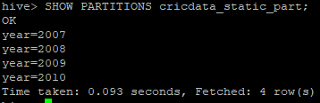
Partitioning in Hive
A table can have one or more partition columns to make query execution faster on slices of the data instead of entire data.
CREATE TABLE cricdata_static_part (pname string, score int, balls int, sixes int, fours int, minutes int, country string) PARTITIONED BY (year STRING) ROW FORMAT DELIMITED FIELDS TERMINATED BY ',';
Static Partition
Use Static partition when you get data specific to partition column separately.
LOAD DATA LOCAL INPATH 'SampleDataFile/player_2007.csv' INTO TABLE cricdata_static_part PARTITION (year='2007');
LOAD DATA LOCAL INPATH 'SampleDataFile/player_2008.csv' INTO TABLE cricdata_static_part PARTITION (year='2008');
LOAD DATA LOCAL INPATH 'SampleDataFile/player_2009.csv' INTO TABLE cricdata_static_part PARTITION (year='2009');
LOAD DATA LOCAL INPATH 'SampleDataFile/player_2010.csv' INTO TABLE cricdata_static_part PARTITION (year='2010');
To see the partitions of a table
SHOW PARTITIONS cricdata_static_part;
Verify the partitioned data in HDFS

Slide 30
Dynamic Partitioning
When you want hive to partition the data and load it to specific partition.
By Default, dynamic partition mode is off, To set it on,
set hive.exec.dynamic.partition=true;
Hive partitioned table requires minimum one static partition column strictly, To avoid this run below,
set hive.exec.dynamic.partition.mode=nonstrict;
Note: We can not directly load partitioned tables with LOAD DATA (LOCAL) INPATH command. Instead, need to use INSERT OVERWRITE TABLE … SELECT …FROM clause from another table.
Create a staging table to load cricketdata
CREATE TABLE stage_cricdata (pname string, score int, balls int, sixes int, fours int, minutes int, country string, year STRING) ROW FORMAT DELIMITED FIELDS TERMINATED BY ',';
Load Data to staging table
LOAD DATA local INPATH 'SampleDataFile/player_partition.csv' INTO TABLE stage_cricdata;

Slide 31
Dynamic partition demo
Create partitioned table
CREATE TABLE cricdata_partitioned(pname string, score int, balls int, sixes int, fours int, minutes int) PARTITIONED BY (country string, year STRING) ROW FORMAT DELIMITED FIELDS TERMINATED BY ',';
Load Data to partitioned table from staging table
FROM stage_cricdata INSERT OVERWRITE TABLE cricdata_partitioned PARTITION (country, year) SELECT pname, score, balls, sixes, fours, minutes, country, year DISTRIBUTE BY country, year;
The below select should fetch data only from partition {country=AUS, year=2007}
select * from cricdata_partitioned where country='AUS' and year ='2007';
To drop partitions of a table
ALTER table cricdata_partitioned DROP PARTITION (country='AUS');
This will also drop year partitions under country=AUS
ALTER table cricdata_partitioned DROP PARTITION (year='2007');
This will drop year=2007 from both the COUNTRY partition AUS and IND
ALTER table cricdata_partitioned DROP PARTITION (country='IND',year='2008');
This will drop year = 2008 only from country= AUS partition.

Slide 32
Bucketing Features
Hive provides Bucketing concept, for decomposing almost equally distributed data file parts.
Similar to Partition concepts, We can not directly load data to bucketed tables but from stage table we can load.
To Enable Bucketing
set hive.enforce.bucketing = true;
Create bucketed table and Load data from cricdata_pname
CREATE TABLE playername_bucketed (pid int,pname string) CLUSTERED BY(pid) SORTED BY (pid) INTO 4 BUCKETS ROW FORMAT DELIMITED FIELDS TERMINATED BY ',';
INSERT OVERWRITE TABLE playername_bucketed SELECT pid,pname FROM cricdata_pname DISTRIBUTE BY pid sort by pid;
Create another bucketed table and Load data from cricdata_pscore
CREATE TABLE playerscore_bucketed (pid int,score int, balls int) CLUSTERED BY(pid) SORTED BY (pid) INTO 4 BUCKETS ROW FORMAT DELIMITED FIELDS TERMINATED BY ',';
INSERT OVERWRITE TABLE playerscore_bucketed SELECT pid,score,balls FROM cricdata_pscore CLUSTER BY pid;

Slide 33
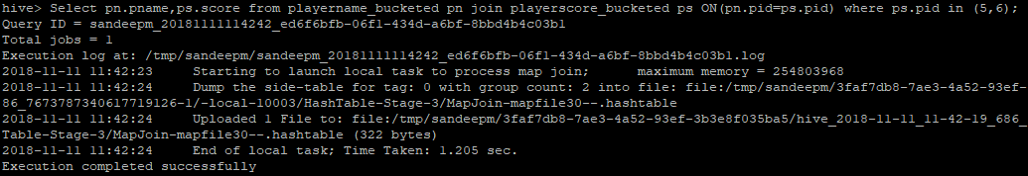
Bucketing Benefits for map join
If Tables being joined are as per below condition then hive optimizes the join by using MapSide join,
bucketized on the join columns,
The number of buckets in one table is a multiple of the number of buckets in the other table, the buckets can be joined with each other
SET hive.optimize.bucketmapjoin=true;
Select pn.pname,ps.score from playername_bucketed pn join playerscore_bucketed ps ON (pn.pid=ps.pid) where ps.pid in (5,6);

Slide 34
Bucketing Advantage
Types of table Sampling in Hive
Using LIMIT clause executes the entire query, and returns limited results.
SELECT pid,score FROM playerscore_bucketed where score<10 limit 5;
TableSample does random sampling based on percentage.
SELECT pid,score FROM playerscore_bucketed TABLESAMPLE (0.1 percent) where score>10 ;
Bucketed Table Sample
SELECT pid,score FROM playerscore_bucketed TABLESAMPLE (Bucket 1 out of 4) where score>10 ; //This will do sampling from mentioned buckets than whole data
Partitioning and bucketing can be used together wherever possible.
CREATE TABLE cricdata_part_bucketed (pname string, score int, balls int, sixes int, fours int, minutes int) PARTITIONED BY (country string, year STRING) CLUSTERED BY(pname) INTO 4 BUCKETS ROW FORMAT DELIMITED FIELDS TERMINATED BY ',';
FROM stage_cricdata INSERT OVERWRITE TABLE cricdata_part_bucketed PARTITION(country, year) SELECT pname, score, balls, sixes, fours, minutes, country, year DISTRIBUTE BY country, year;

Slide 35
Hive UDF
UDF is a java code which must satisfy the following two properties.
UDF must implement at least one evaluate() method
UDF must be a subclass of org.apache.hadoop.hive.ql.exec.UDF
import org.apache.hadoop.hive.ql.exec.UDF;
import org.apache.hadoop.io.Text;
public final class MyLowerCap extends UDF {
public Text evaluate(final Text s) {
if (s == null) { return null; }
return new Text("MR " + s.toString().toLowerCase());
}
}
Use UDF in hive
add jar jar/HiveUDF-0.0.1-SNAPSHOT.jar;
create temporary function greetName as 'com.programs.HiveUDF.MyLowerCap';
select greetName(pname) from cricdata;

Slide 36
Performance Tuning
Create de-normalized tables.
Using EXPLAIN (describes how Hive translates queries into MR jobs)
EXPLAIN SELECT COUNT(pname) FROM cricdata;
Use Partitioning and bucketing features wherever possible.
While using joins on Bucketing tables set below to enable map side join if possible.
Compress map/reduce output:
For map output compression set mapred.compress.map.output to true
For job output compression set mapred.output.compress to true
Use Map Join where possible
Set hive.auto.convert.join = true;
You can improve the performance of aggregation in the map phase (Combiner)
SET hive.map.aggr=true;
SELECT COUNT(pname),max(score) FROM cricdata;
Use Parallel execution:
set hive.exec.parallel = TRUE;
set hive.exec.parallel.thread.number = 4; //To control how many jobs at most can be executed in parallel

Slide 37
Limitations of Hive
Hive can’t be used for the problems that require response in milliseconds. Since hive launces MR job for most of the queries this staging takes time
HIVE Queries are structural, you have to clearly specify what needs to be performed in what order using subqueries. This can become tedious if there are complex number of steps to be executed. For this Pig can be used which is more procedural like language, where the sequence of steps to be performed can be mentioned with individual statements
Splitting data: Data at various stages is merged and combined by SQL and in the end a single result is obtained. Hence splitting is not possible. Pig on the other hand can be used to save the result at different stages.

